Slide 1
Where your
DOLLARS
go…
2014

Slide 2
Where your DOLLARS go…
2014 MUSICAL PRODUCTION
$5,000

Slide 3
Where your DOLLARS go…
ELECTRONIC
SIGN
$50,000

Slide 4
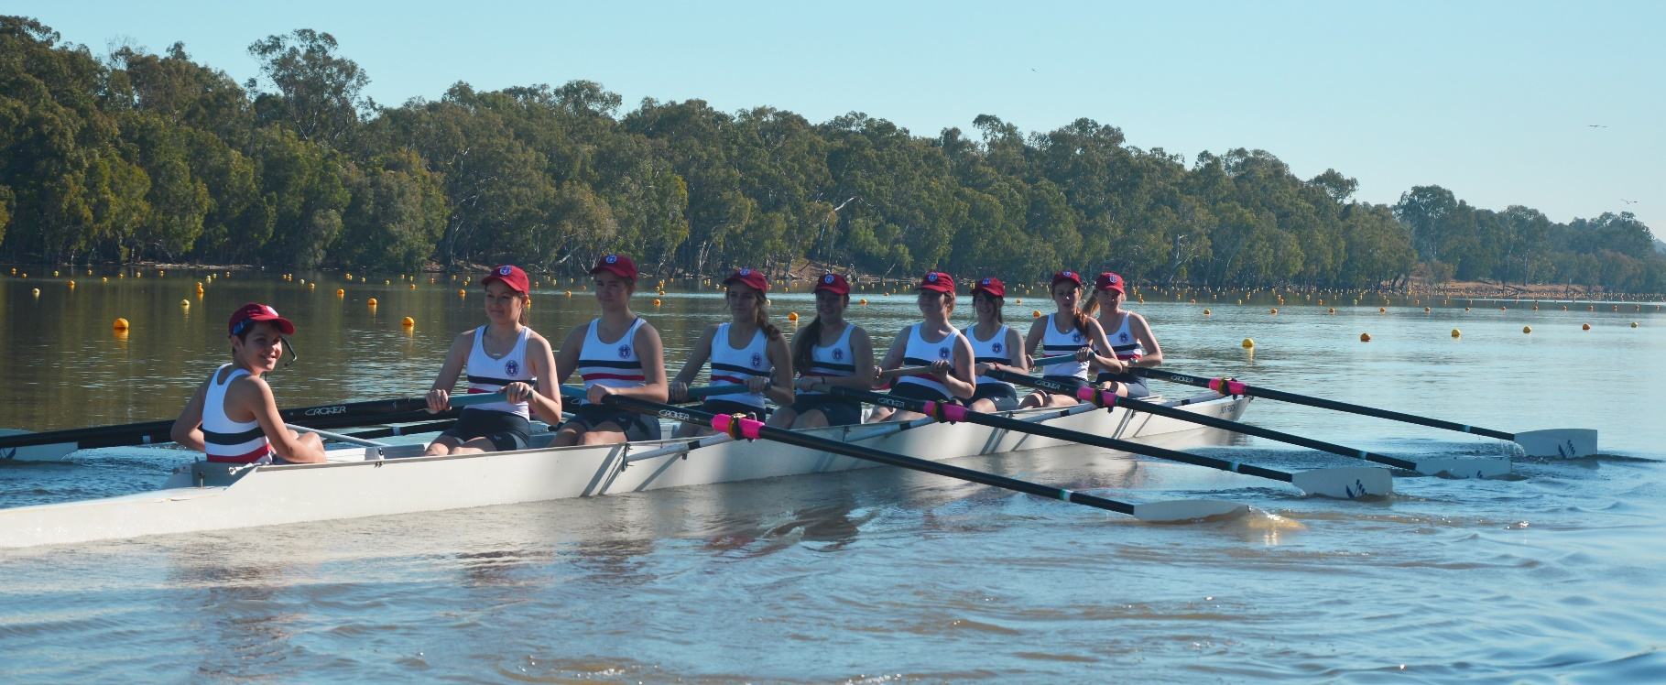
Where your DOLLARS go…
EMMAUS
ROWING
$15,000

Slide 5
Where your DOLLARS go…
LAPTOP
PROGRAM
$5,600

Slide 6
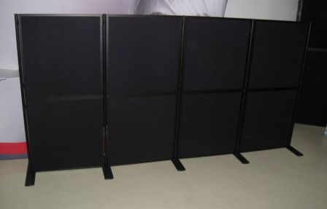
Where your DOLLARS go…
DISPLAY
BOARDS
$10,000

Slide 7
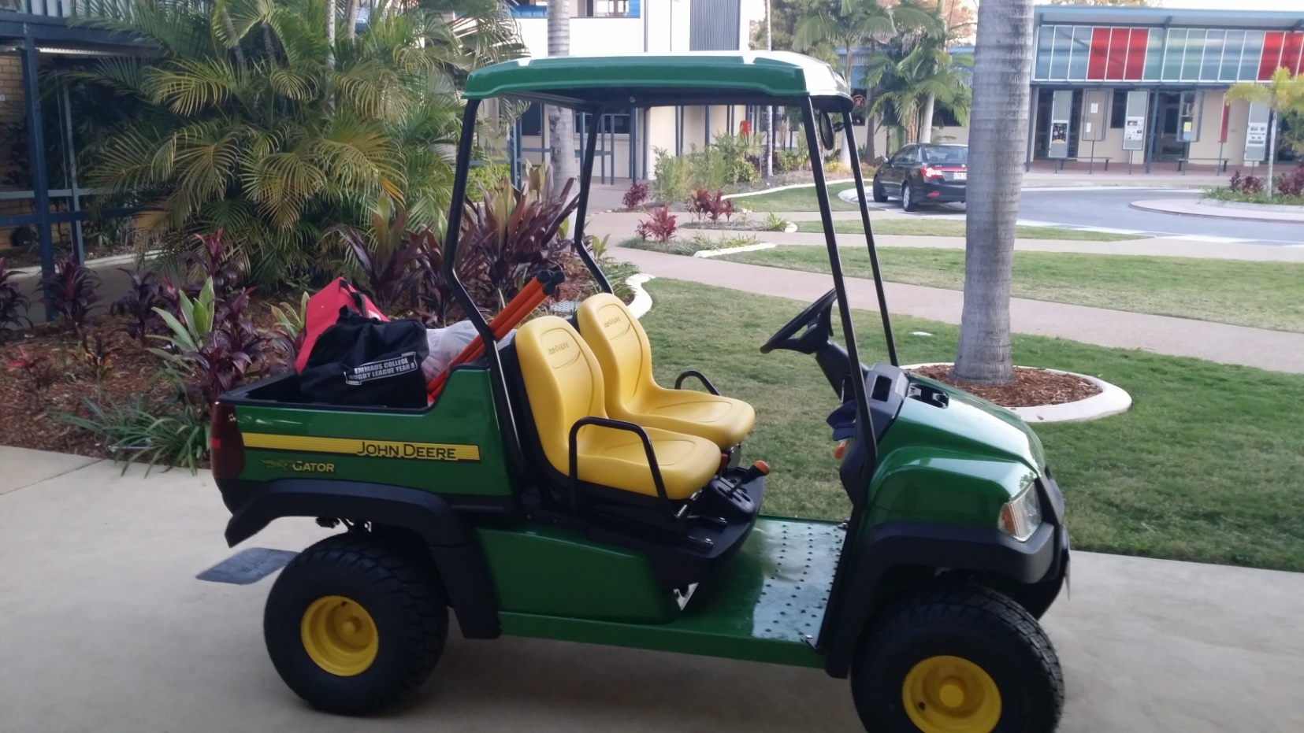
Where your DOLLARS go…
GATOR
$7,000

Slide 8
Where your DOLLARS go…
GRADUATION
DRINKS
$3,300

Slide 9
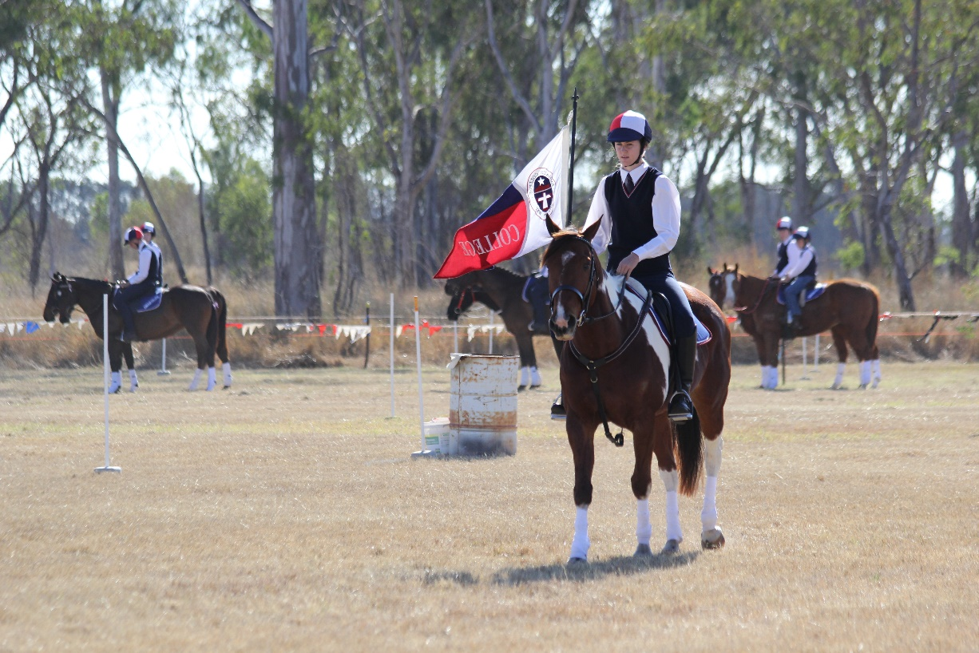
Where your DOLLARS go…
EQUESTRIAN
$5,600

Slide 10
Where your DOLLARS go…
ECO
GARDEN
$2,000

Slide 11
Where your DOLLARS go…
GYM
EQUIPMENT
$5,000

Slide 12
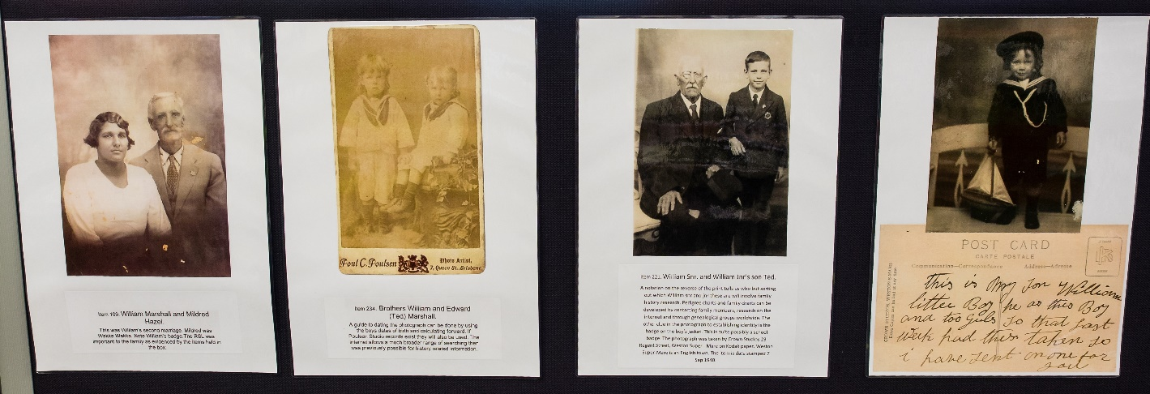
Where your DOLLARS go…
HISTORY IN A BOX
$5,000

Slide 13
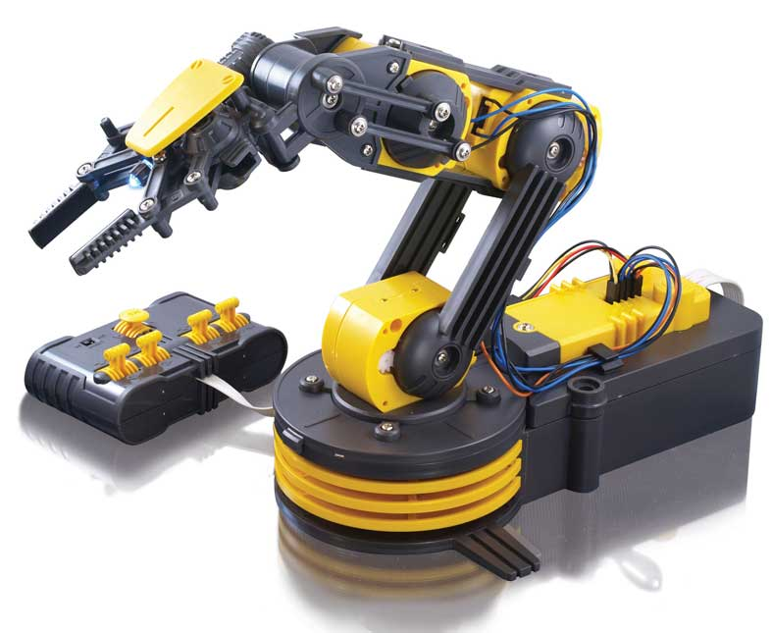
Where your DOLLARS go…
ROBOTICS
$12,000

